Slide 1
KONTENA SHOW CASE
Presented By :SANTHOSH KUMAR HIREKERUR

Slide 2
AGENDA
About Kontena
About Project Architecture and “KONTENA.IO”
Creating nodes using templet (ADD,DELETE,AUTO DETECT)
Infra Services (Reverse proxy, webhook,gogs,registry,registry Web)
Dev Services
About “KONTENA CLI” and Some important commands

Slide 3
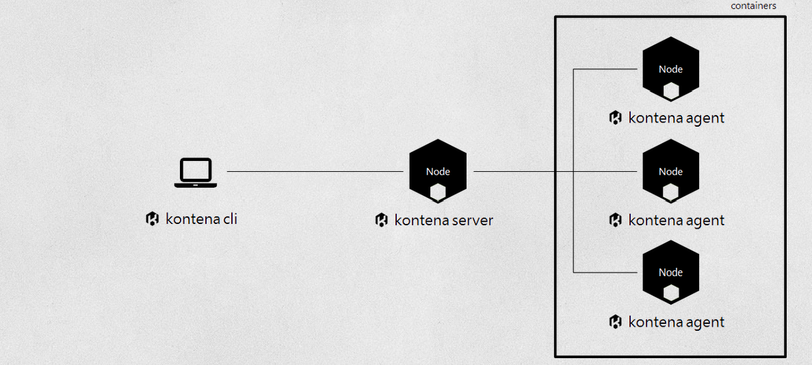
About Kontena

Slide 4
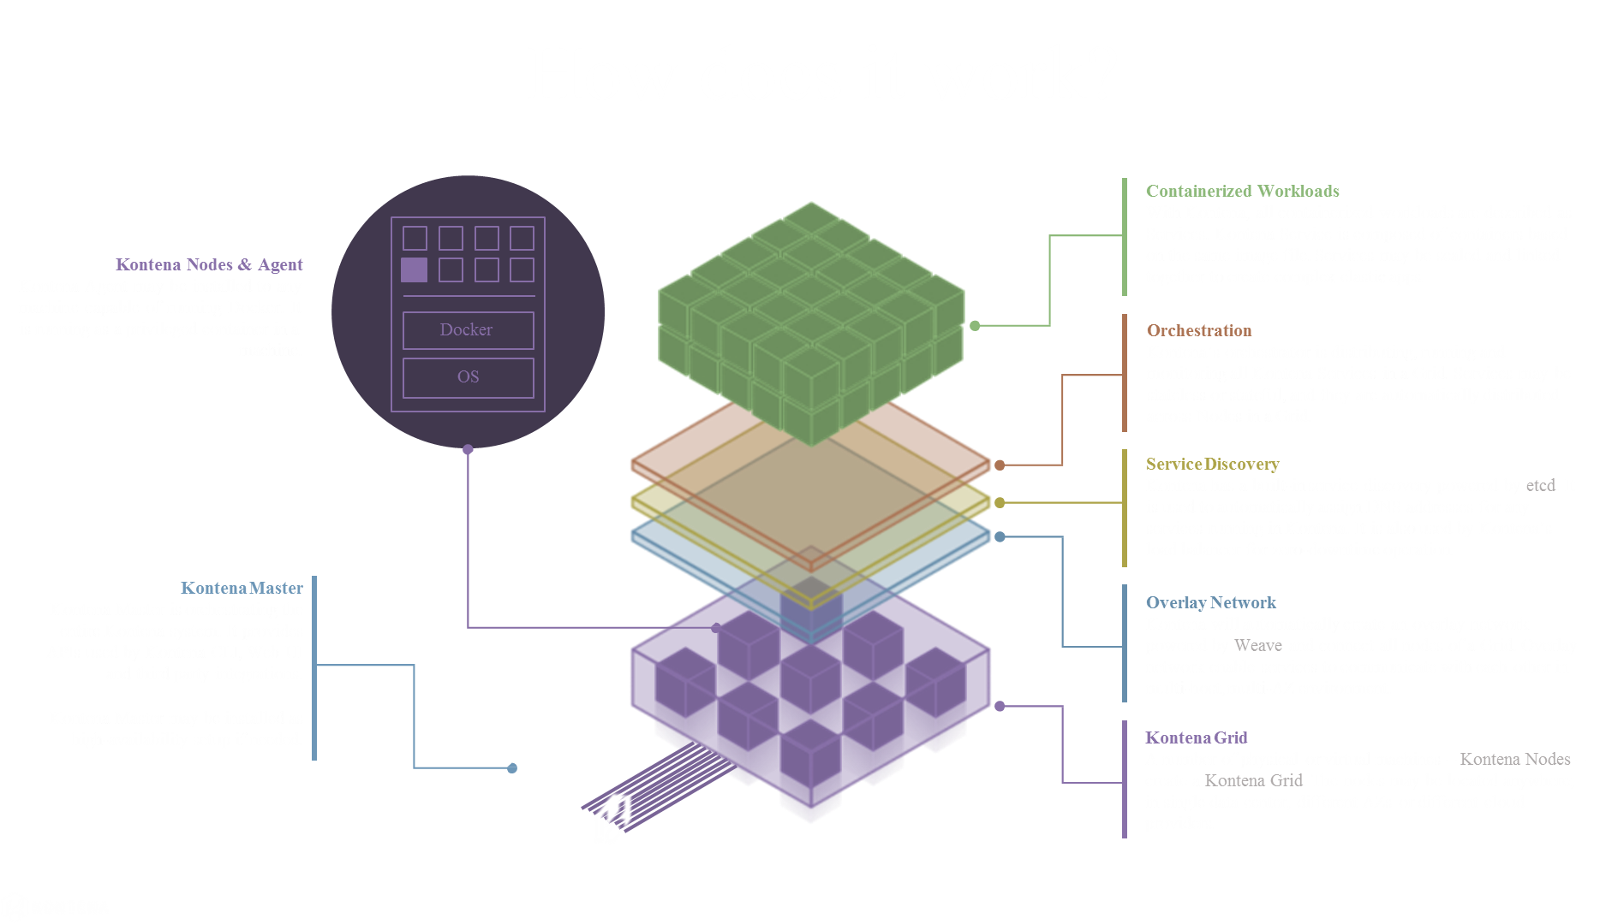

Slide 5
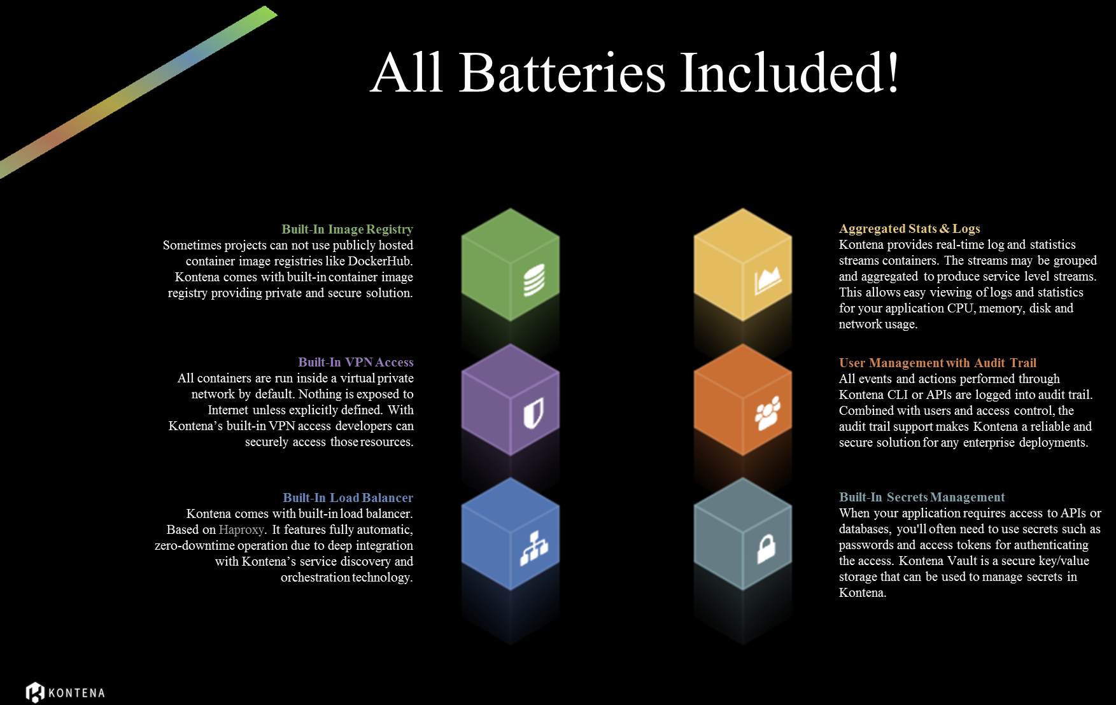

Slide 6
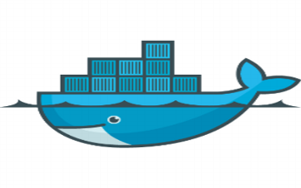
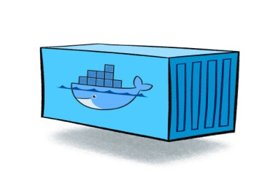
MINIMUM GRID (Multi-Host VPN) Deployments
registry.<gridName>.kontena.cookapac.com (Store image)
registryWeb.<gridName>.kontena.cookapac.com (web)
← Custom image repository->
Inner-load balancer
service1
service2
*.<gridName>.kontena.cookapac.com
Outer-load balancer

Slide 7


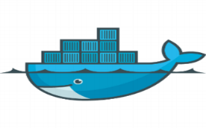

DNS ROUTING (Example)
registryWeb.cbr-dev.kontena.cookapac.com
Frontend (public)
*.cbr-dev.kontena.cookapac.com
cbr-infra
cbr-dev
<gridname>
<gridname>
<gridname>
backend (private)
registryWeb.cbr-dev.kontena.cookapac.com
cbr-dev
Outer-load balancer

Slide 8


Intranet & / or
Internet
GRID Access
App requests
gogs.kontena.cookapac.com
registryweb.cbr-infra.kontena.cookapac.com (view)
registry. cbr-infra.kontena.cookapac.com (Store image)
webhook.kontena.cookapac.com
gridDiscovery.kontena.cookapac.com
CBR-INFRA GRID
webhook
whomami.cbr-dev.kontena.cookapac.com
whoami
CBR-DEV GRID

Slide 9

How to add new grid nodes?
Go to Vmware Vsphere chose the “master” templet
Create VM machine from master templet with proper IP
At first login >> “ls” command list below files
certificates env.sh init-server.sh prepare_ubuntu_template.sh README.md template.yml
Execute ./init-server.sh
This script creates “docker-compose.xml”
Executre docker-compose up -d
Note:Make sure before execute the “init” script “webhook” docker is running.
WHY?

Slide 10
Walk through “docker-compose.xml” file
root@AUS-INFRA-D1-0:~# cat docker-compose.yml
version: '2'
services:
agent:
container_name: kontena-agent
image: kontena/agent:latest
network_mode: host
restart: unless-stopped
environment:
- KONTENA_URI=wss://10.61.40.100:443/
- KONTENA_TOKEN=N7aYiEFCYlMuf9efAofT+x+VQBNfofElE3Ps3pQXZH/Jw51B8ZFBQ/tWNTAVt5mL3QEgIroBGLsTxZSB6z3fPg==
- KONTENA_PEER_INTERFACE=eth0
- KONTENA_PUBLIC_IP=10.61.40.107
volumes:
- /var/run/docker.sock:/var/run/docker.sock
How the right master uri and taken values fetched here?

Slide 11


WEBHOOK
>> push grid-routes.json
1. Curl KONTENA_URI and KONTENA_TOKEN
2. Get KONTENA_URI and KONTENA_TOKEN
webhook
./init-server.sh
3. Update docker-compose.xml file

Slide 12
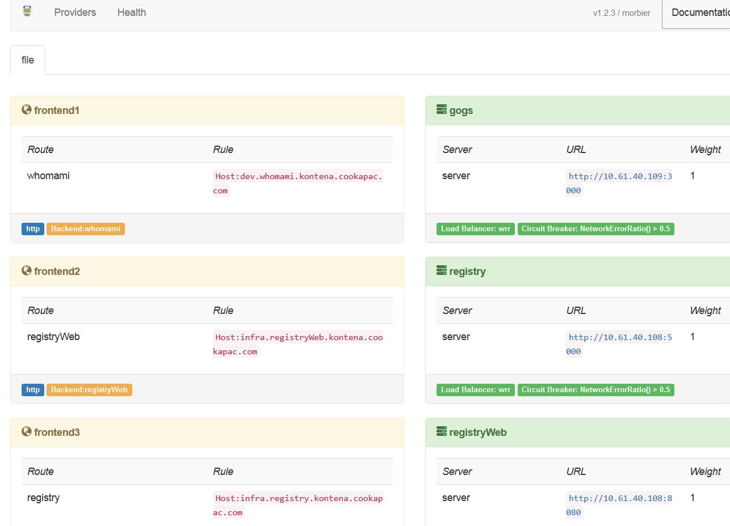
TRAEFIK

Slide 13
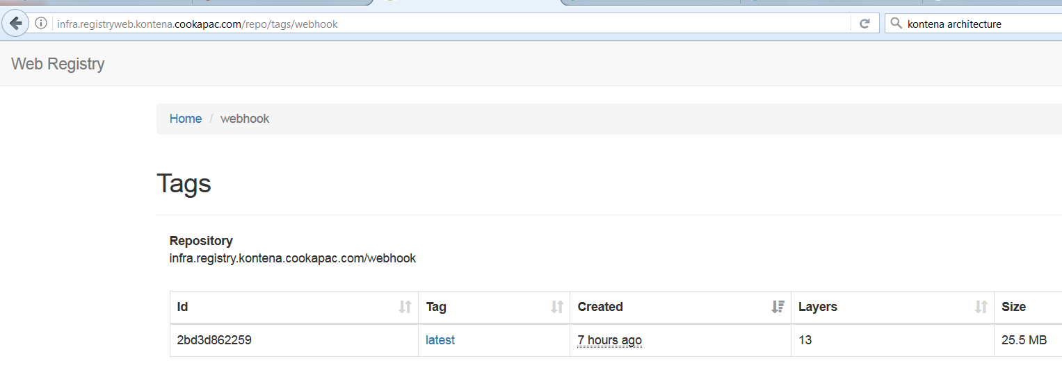
DOCKER REGISTRY

Slide 14
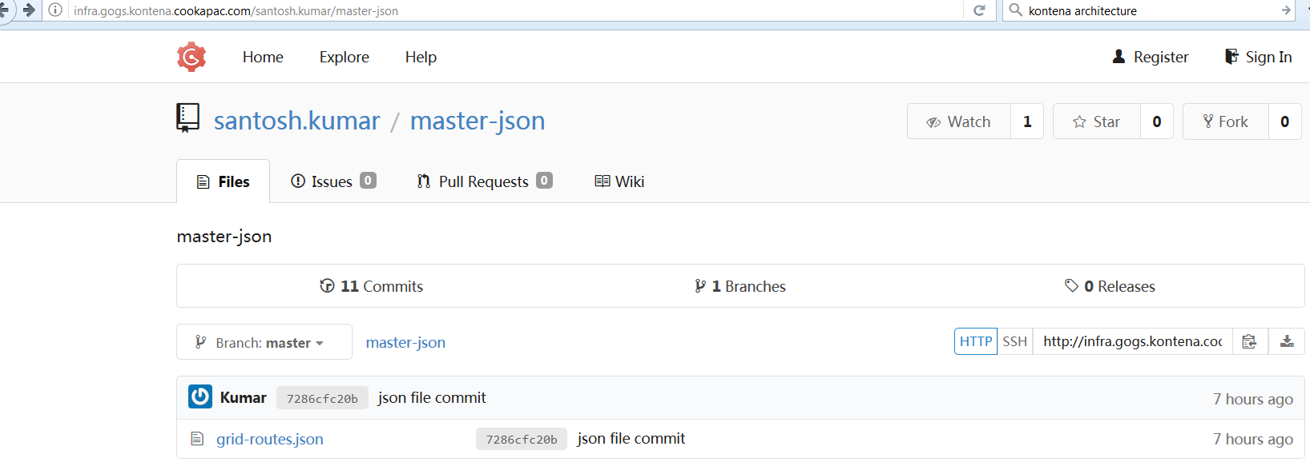
GOGS

